Slide 1
Summer training
DATA SCIENCE AND ML WITH PYTHON
COMPLETED IN DUCAT

Slide 2
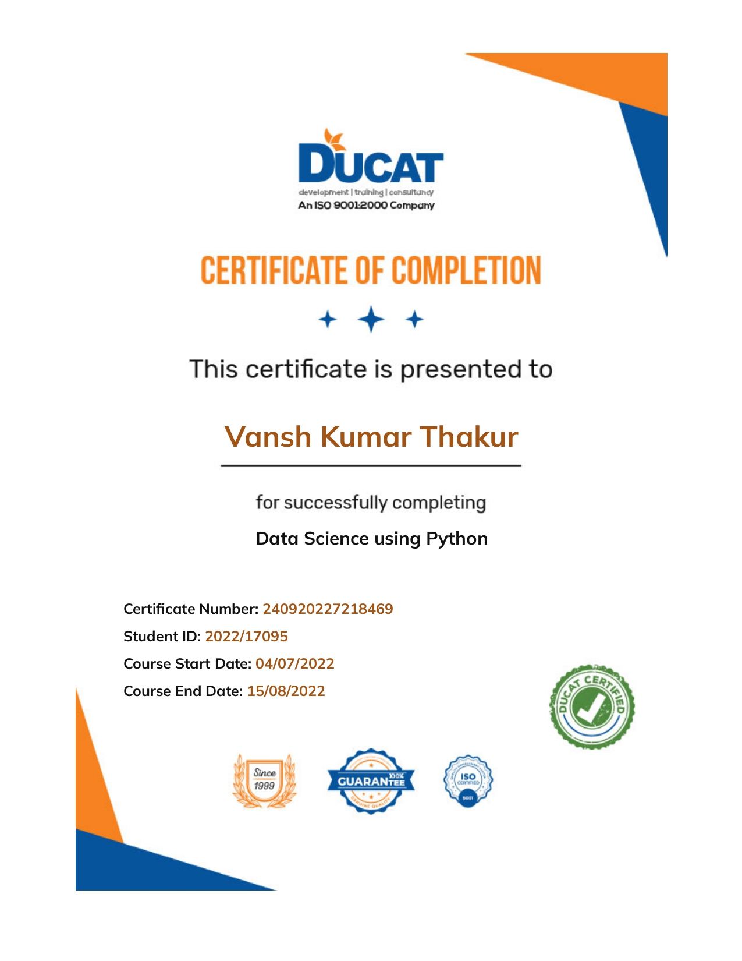
COMPELETION CERTIFICATE

Slide 3

ABOUT DUCAT
Getting a job is as difficult as beating the crowd because being in the corporate world demands a lot from the applicant because of which the applicants are putting their best, which results in the increment of difficulty level. You can see each and every thing is connected but the solution of this problem is either spending years to reach to a desired position or come to Ducat. At Ducat we provide the entire necessary computer training which helps the newbies and also the experienced workers so that they can achieve better recognition in this competitive world.

Slide 4
ABOUT DATA SCIENCE
Data science is an in-demand career path for people with an aptitude for research, programming, math, and computers. Discover real-world applications and job opportunities in data science and what it takes to work in this exciting field.
Data science is an interdisciplinary field that uses algorithms, procedures, and processes to examine large amounts of data in order to uncover hidden patterns, generate insights, and direct decision making. To create prediction models, data scientists use advanced machine learning algorithms to sort through, organize and learn from structured and unstructured data.
As a fast growing field with application across numerous industries, data science offers a variety of job opportunities – from researching to computing. In this article, you will learn about how data science is used in the real-world, the job outlook for the field, its required skills, and what credentials you need to land a job.

Slide 5
BANK PROJECT
Digital Transformation in Banking Sector Using Data Science With Python
Although banks do many things, their primary role is to take in funds—called deposits—from those with money, pool them, and lend them to those who need funds. Banks are intermediaries between depositors (who lend money to the bank) and borrowers (to whom the bank lends money). The amount banks pay for deposits and the income they receive on their loans are both called interest.
“Digital Transformation in Banking Sector Using Data Science With Python” main motive is to grow the customer base of asset customers (depositors). It is in the best interest of the banks because it will help them to gain more borrowers which will lead to more business via loan interest.

Slide 6
Problem to work on
To earn the profit bank lends money to an individual or any business.
The earning is in the form of interest applied on there lending amount.
Whereas in case of depositors there is no. profit to the bank, instead bank has to provide interest to there customers for long term assurance.
Therefore borrowers are an asset to every bank.
Increasing the no. of borrowers means increase in banking business.

Slide 7
How will we solve this problem?
With the help of this project we can predict that a person will apply for the loan or not.
This will happen with the help of the data.
Data is known as the strongest power in a persons hands these days, with the help of useful data a person can manipulate any industry.
Data can be collected from the bank server itself and with the help of that data and data science we can predict that the customer will take the loan from the bank or not.

Slide 8
Data description
We have 2 datasets in the form of CSV files,
• Data1 - 5000 rows and 8 columns
• Data 2 - 5000 rows and 7 columns
The data consists of the following attributes:
1. ID: Customer ID
2. Age Customer’s approximate age.
3. CustomerSince: Customer of the bank since. [unit is masked]
4. HighestSpend: Customer’s highest spend so far in one transaction. [unit is masked]
5. ZipCode: Customer’s zip code.
6. HiddenScore: A score associated to the customer which is masked by the bank as an IP.
7. MonthlyAverageSpend: Customer’s monthly average spend so far. [unit is masked]
8. Level: A level associated to the customer which is masked by the bank as an IP.
9. Mortgage: Customer’s mortgage. [unit is masked]
10.Security: Customer’s security asset with the bank. [unit is masked]
11.FixedDepositAccount: Customer’s fixed deposit account with the bank. [unit is masked]
12.InternetBanking: if the customer uses internet banking.
13.CreditCard: if the customer uses bank’s credit card.
14.LoanOnCard: if the customer has a loan on credit card

Slide 9
Processes in a data science project
EDA (EXPLOITARY DATA ANALYSIS) AND PREPROCESSING
STATISTICAL ANALYSIS
GRAPHICAL ANALYSIS
SPLITING THE DATA INTO TRAIN AND TEST DATA
SELECTING A SUITABLE MODEL AS PER YOUR DATA SET
TRAINING THE MODEL WITH TRAIN DATA
TESTING THE DATA WITH TEST DATA
ANALYSIS OF THE MODEL USING VARIOUS METRICES

Slide 10
approach
In this project we have categorical type data which means we have numerical dataset with multiple variables.
Cleaning the data set by checking for missing values and null values.
Analysing the variables by checking the correlation.
After checking the data one last time for any impurities then we split the data into train and test dataset using sklearn train_test_split
As we have categorical data therefore we will use decision tree classifier as the data we have is not so large to use random forest or any other model.
We will then train the model with train data set and then test it using the test data set.
At the end we will check the metrics score to see the reliability of the model.

Slide 11
Result and conclusion
After going through all the results of metrices we can say that our model is very good as we have achieved the accuracy of 97% with this model.
This software now can be used by the banking firms to approach the potential borrowers and increase there asset customers, thus increasing there profits and increasing the business.
This will help in saving time of the marketing department as now they will have no need to call every person to ask for a loan instead they will only have to call the customers who are shown by the program.
We can say that data science can be revolutionary for any industry if used properly.

